Slide 1
IOT Presentation
Crop Yield Prediction & Smart Irrigation

Slide 2

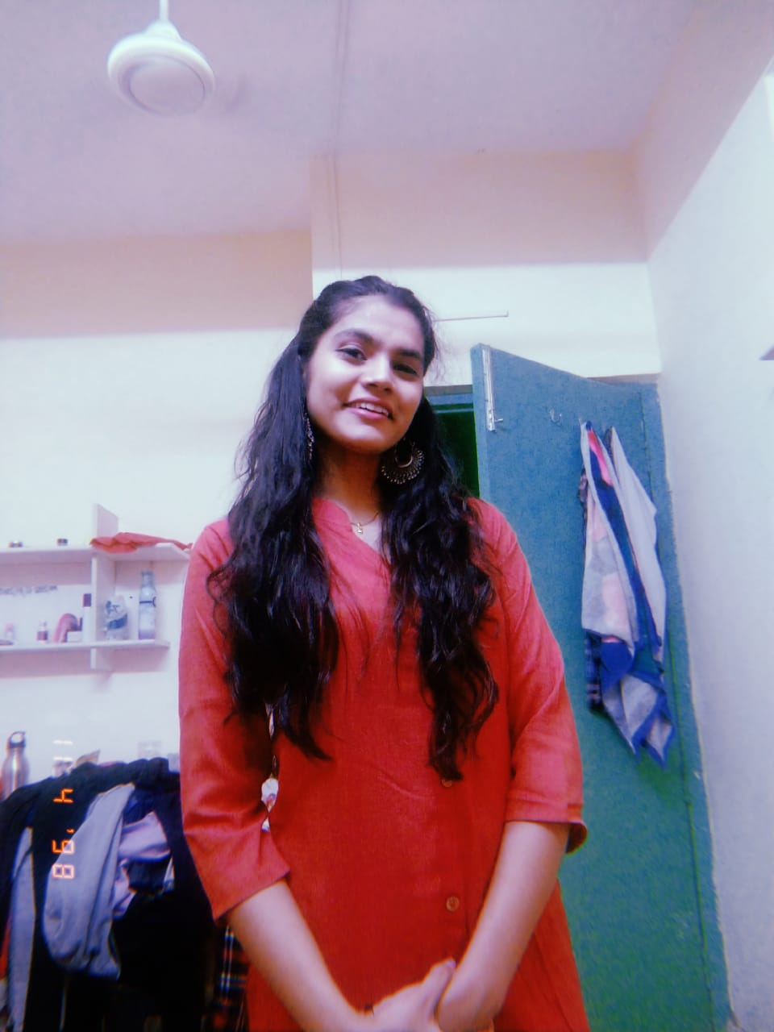

Our team
Denna Doe
Timmy Jimmy
Susan Bones
Avishek Roy
Research and Technical Developer
Archa Dave
Research and Project Manager
Chirag Chawla
Research and Tech Desk

Slide 3
Timeline Of The Project
Ideation
Prototyping
Research and Report completion
Final Presentation
1
2
3
4

Slide 4
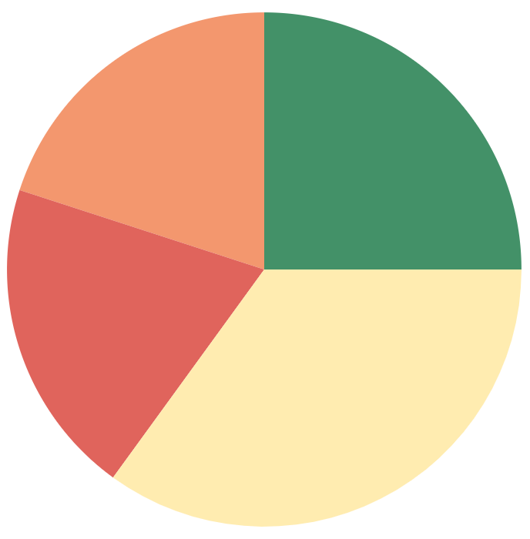
Distribution of work
Research
Hardware
Software
Final Prototyping
20%
25%
20%
35%

Slide 5
Table of contents
01
02
03
Our idea
Application Scenario
Methodology
04
05
06
Proposed Solution
Business Partner
Future Scope

Slide 6
Problem Statement
Design a dashboard or APP that will give crop
yield estimation, to improve the crop output and
efficient use of fertilizers.

Slide 7
YIELD ESTIMATION
Yield monitoring is the mechanism used to analyze various aspects corresponding to agricultural yield, like grain mass flow, moisture content, and harvested grain quantity.
Predicting the right harvesting time not only helps to maximize the crop quality and production but also provides an opportunity to adjust the management strategy.
Wireless sensors placed strategically around fields are providing farmers with up-to-date information in real-time, allowing them to adapt the care that the crops need, which results in higher food production with less waste.

Slide 8
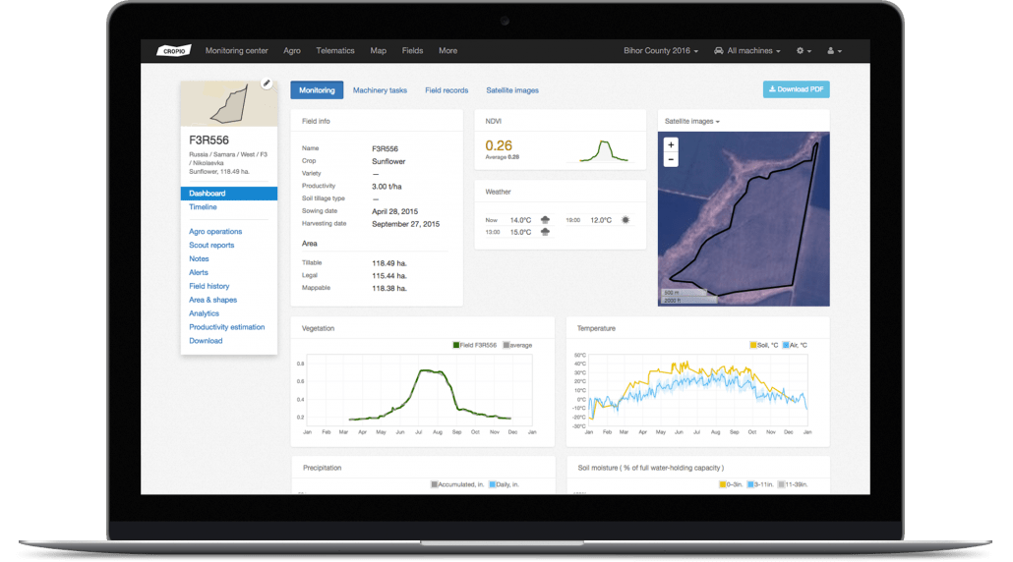
Our Idea
We worked on a Web application approach
It can give approximation on amount of crop yield gainers and losers.
The application uses a Random Forest Machine Learning model.
The model achieved an accuracy of around 86%and can be even further improved with more data.
There are many types of IoT sensors for agriculture that are been used.

Slide 9
Application Scenario

Slide 10
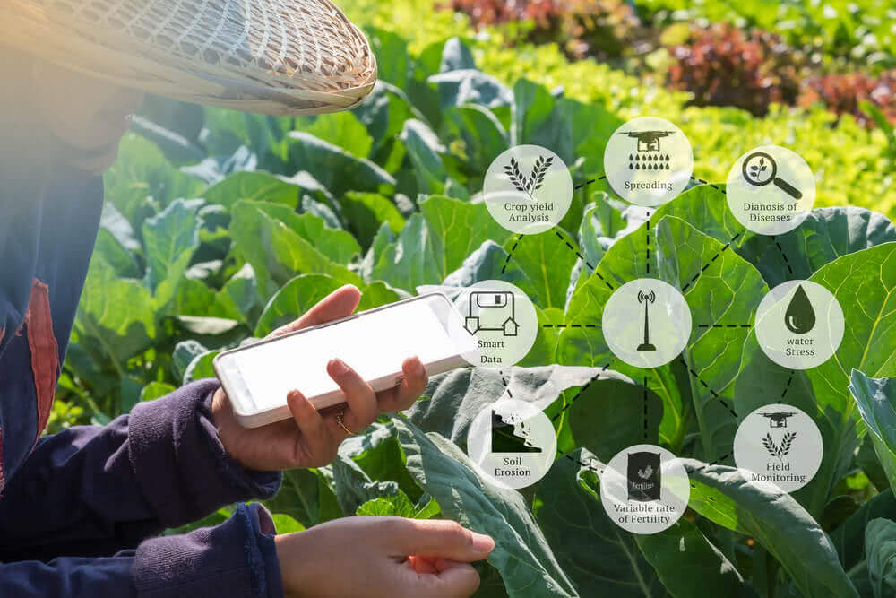
Precision farming
Livestock Monitoring
Monitoring Climate Conditions
Crop assessment and Yield estimation

Slide 11
Methodology

Slide 12
01
Exploratory data analysis

Slide 13
02
Training Model

Slide 14
03
Analysis/ Evaluation

Slide 15
04
Building a
Flask Webpage

Slide 16
05
Deploying the
Model

Slide 17

Proposed
Solution

Slide 18
Using hardware analyzing values of moisture level, atmospheric pressure and weather prediction.
Yield prediction using neural networks.
All the data will be sent through arduino to data cloud forming data sets.
The data sets will be either stored in databases or in cloud services.
Then circuit will be formed and using flask all the data will be transfer to our dashboard.
Then our dashboard will predict all the product which had a extreme gain or extreme loss in their profit margin.
In dashboard all the data has been analyzed semantically.

Slide 19
Importance Comparison Between Genotype and Environment(Weather Prediction)
To compare the individual importance of genotype, soil and weather components in the yield prediction, we obtained the yield prediction results using following models:
DNN(G): This model uses the DNN model to predict the phenotype based on the genotype data (without using the environment data), which is able to capture linear and nonlinear effects of genetic markers.
DNN(S): This model uses the DNN model to predict the phenotype based on the soil data (without using the genotype and weather data), which is able to capture linear and nonlinear effects of soil conditions.
DNN(W): This model uses the DNN model to predict the phenotype based on the weather data (without using the genotype and soil data), which is able to capture linear and nonlinear effects of weather components.

Slide 20
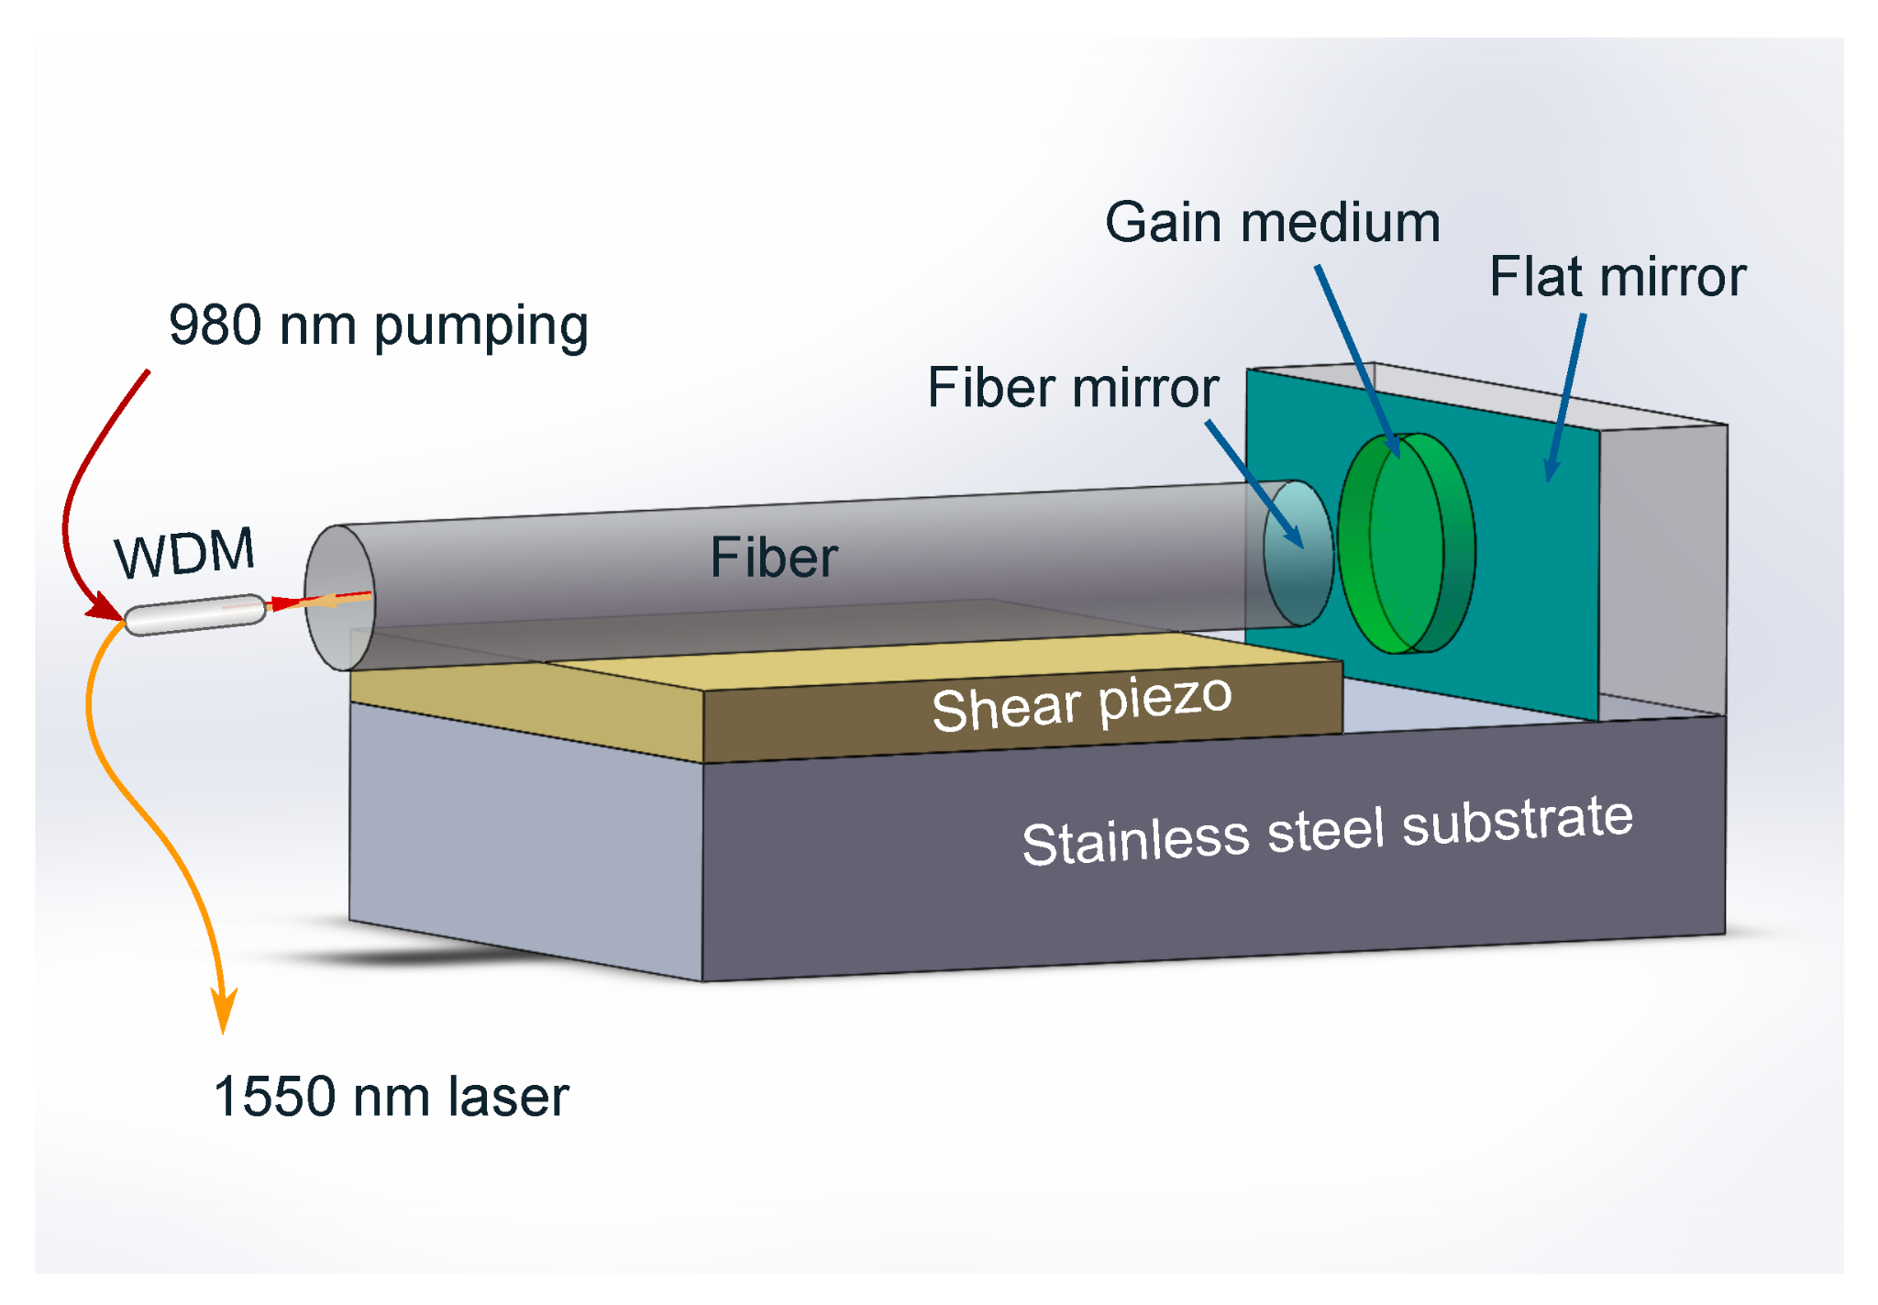
Hardware Tools
THE ARDUINO UNO
SOIL MOISTURE SENSOR
TEMPERATURE AND HUMIDITY SENSOR
ACOUSTIC SENSORS
OPTICAL SENSORS

Slide 21




Software Technology

Slide 22


Libraries Used
Flask
Pandas
Numpy
Datetime
Random(Forest Machine Learning Model)

Slide 23

Business Partner
We would need to find the business partners according to the following
Services.
● Value Chain Studies
● Crop Surveys- Sowing Intention, Acreage and Yield estimation
● Crop Cutting Experiments (CCEs) and Monitoring
● Impact & Evaluation Studies

Slide 24
Business Partner(Contd.)
Farmer’s training & capacity building
Advisory and Consulting on commodities
Customize research Reports
Irrigation Patterns in different seasons
Market assessment and entry strategy

Slide 25
Private
Public
● TATA AIG
● AGRICULTURE INSURANCE COMPANY
● BAJAJ ALLIANZ and IFFCO TOKIO
● Hindustan Gum
● Cargill
● P&G
● Nestle
● ITC
● Godrej, Mitsubishi Corp
● FCI
● Ministry of Agriculture
● STC
● PEC
● SFAC
● AIC
● Ministry of Consumer Affairs
● Food & Public distribution
● Horticulture Board

Slide 26
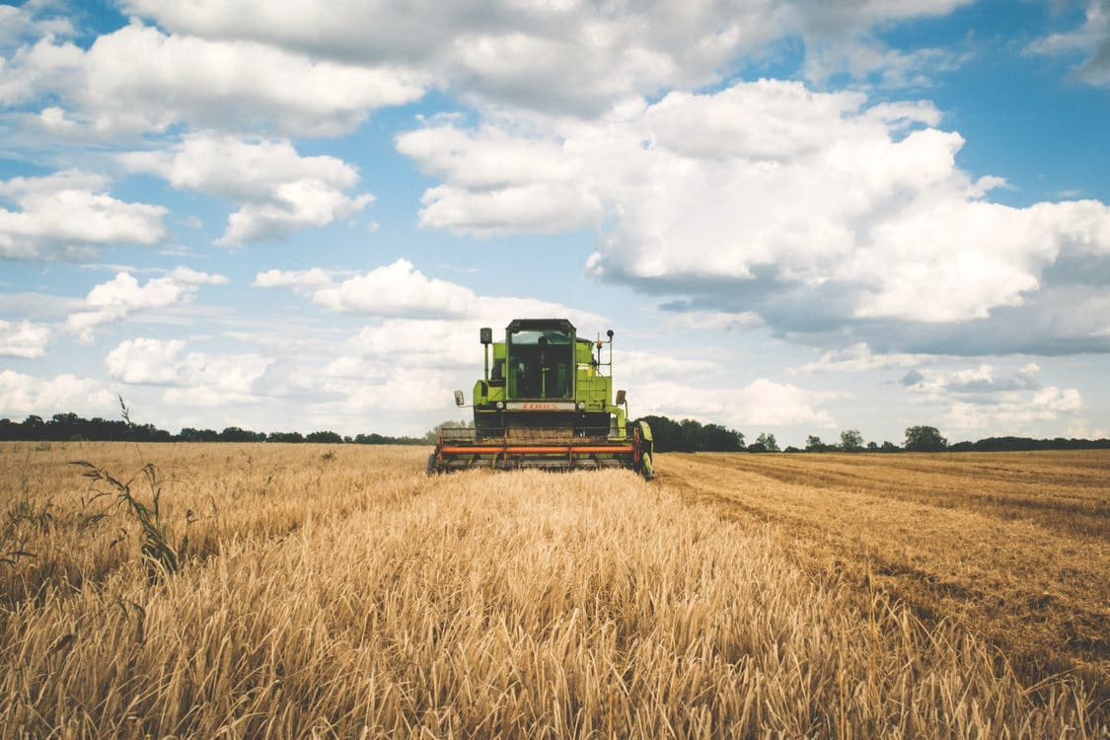
IOT Applications in Smart Agriculture
1. Monitoring of climate conditions
2. Crop management
3. Precision farming
4. Predictive analytics for smart farming

Slide 27
AI IN AGRICULTURE
AI technology helps yield healthier crops, control pests and diseases, monitor soil and growing conditions, organize data for farmers, etc.
The most popular applications of Artificial Intelligence in agriculture are Agricultural Robots, Predictive Analytics, Crop &amp; Soil Monitoring, Computer vision, etc.
Machine learning models are used to track and predict several environmental impacts on crop yield such as weather changes.

Slide 28


Dashboard

Slide 29
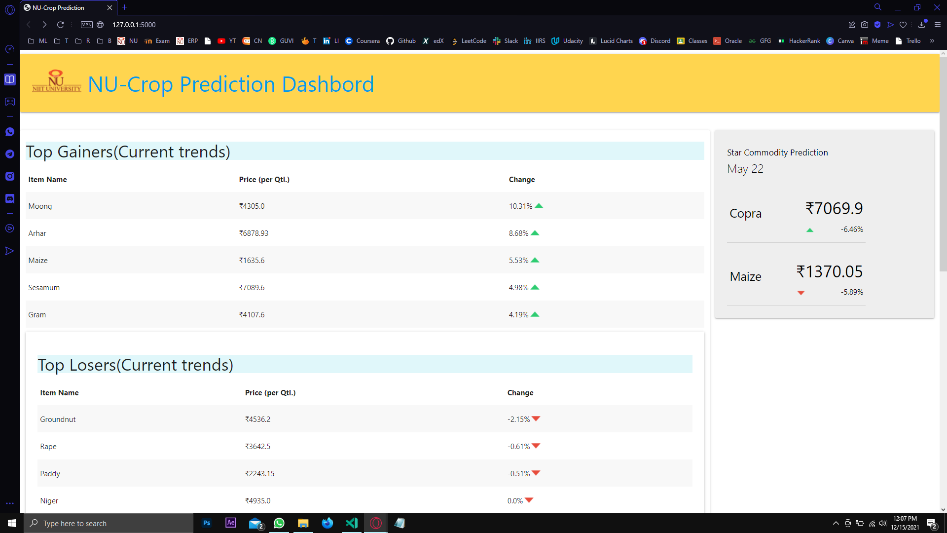

Slide 30
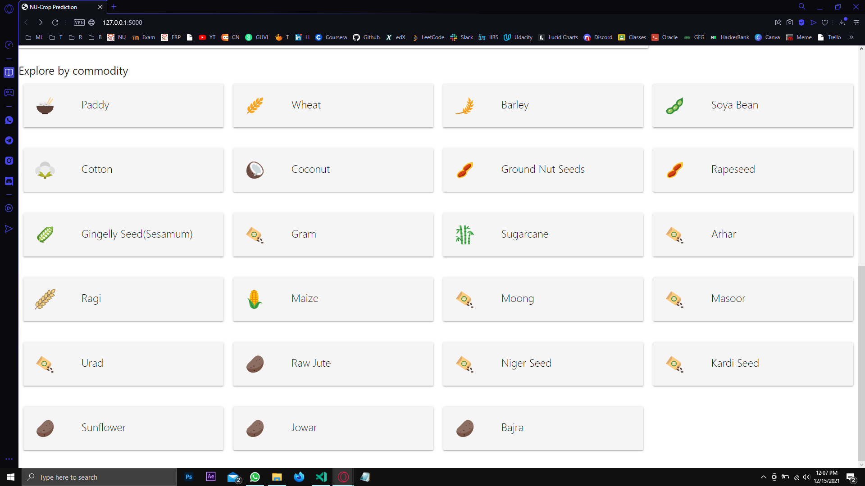

Slide 31
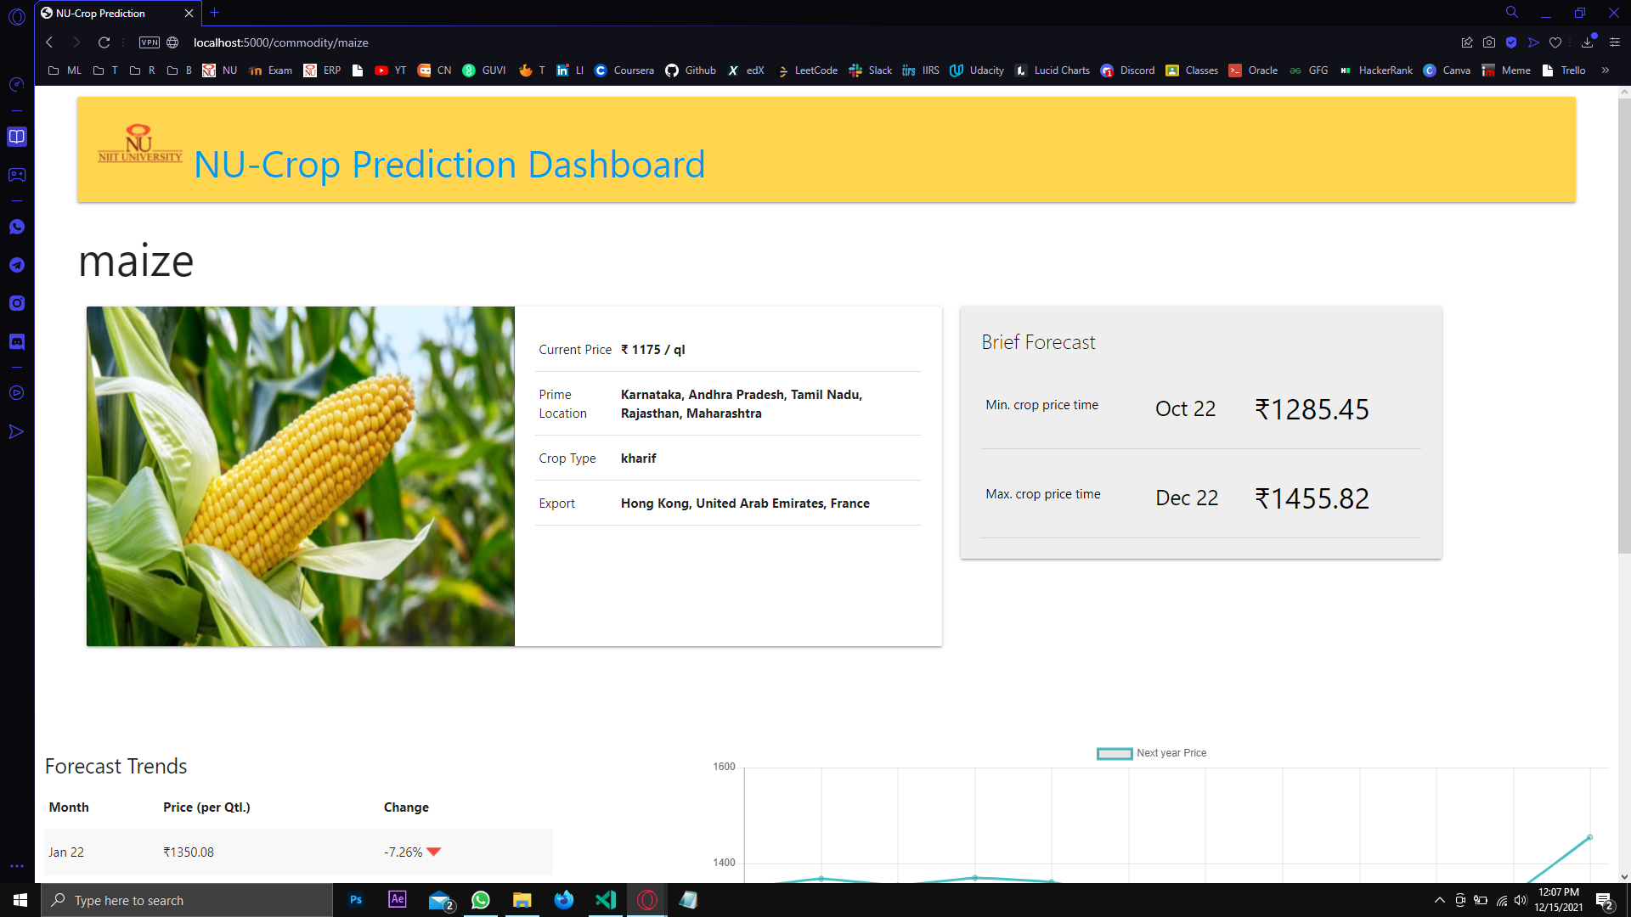

Slide 32
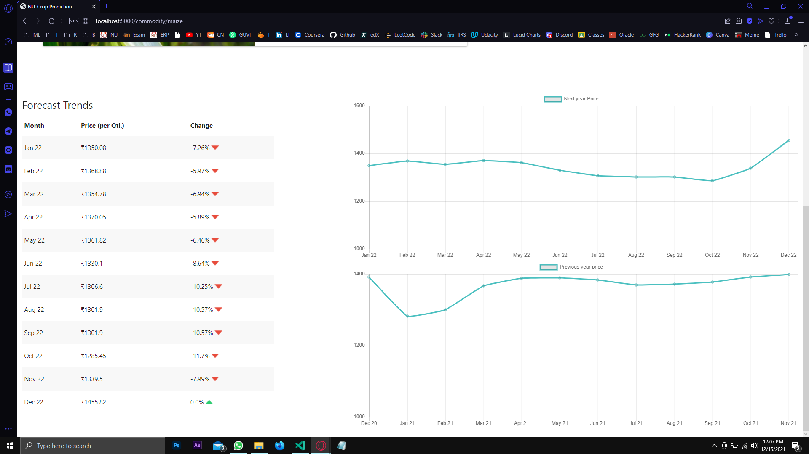

Slide 33
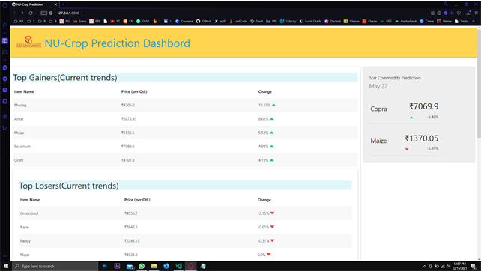
Project Demo

Slide 34
IOT ENABLING TECHNOLOGIES
Cloud Computing (CC)
Wireless Sensor Networks (WSN)
Big Data Analytics
Communication Protocol
Embedded Systems (ES)

Slide 35
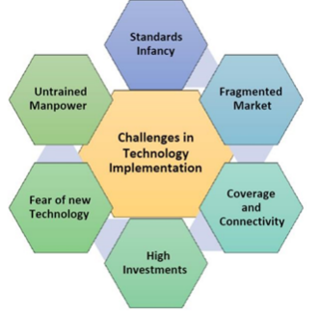
Challenges ahead

Slide 36
Future Scope

Slide 37
The future of the IoT can be shaped by the phenomenal advances in WSNs and the fifth generation (5G) of cellular mobile communication technologies to provide farmers with real-time data and information anytime and everywhere their land is.
Based on recent success, it is estimated that more than 75 million IoT-based devices will be operating in the agriculture industry by 2020. Further, the average farm is expecting to generate 4.1 million data points on a daily basis by 2050.

Slide 38
Problem Statement
Design a solution that will help to have better water management in irrigation

Slide 39
Solution
Monitor Environmental Factors such as:
Temperature
Humidity
Soil moisture
Using this data turn ON/OFF motor automatically.

Slide 40
A significant increase in crop efficiency is expected with the use of IoT-based techniques, such as crop water stress index (CWSI)-based irrigation management.
For this, knowing crop condition at different periods and air temperatures is needed for the calculation of CWSI.
A wireless sensors-based monitoring system where all the field sensors are connected to collect the mentioned measurements, further transmitted to a processing center where corresponding intelligent software applications are used to analyze the farm data.
Designing a solution that will help to have better water management in irrigation

Slide 41
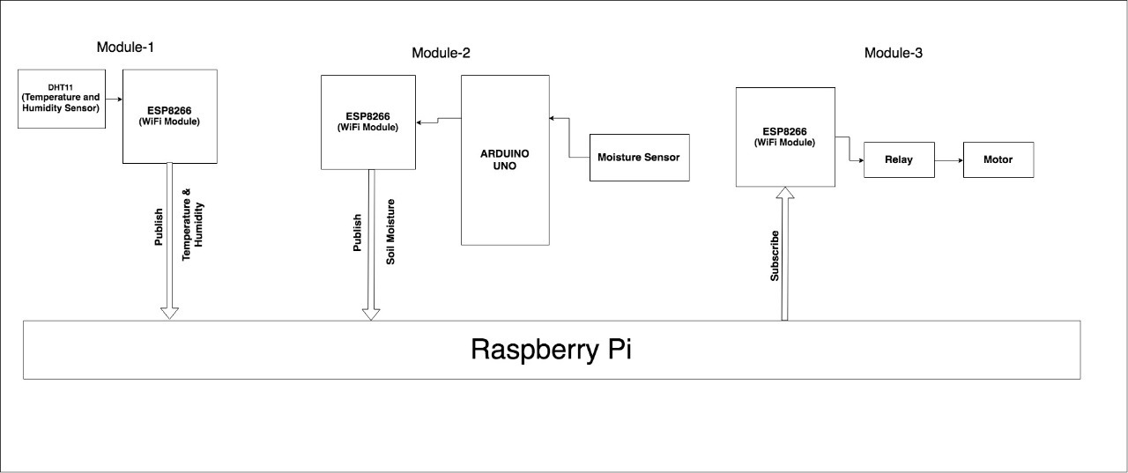
Block Diagram

Slide 42
Modules Used

Slide 43
Module-1
In the first module we are using ESP8266 Wifi module that will act as a microcontroller and it will attached to a DHT11 to sense the current temperature and humidity.
The module will publish the temperature and humidity data to MQTT broker i.e Raspberry Pi.

Slide 44
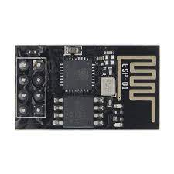
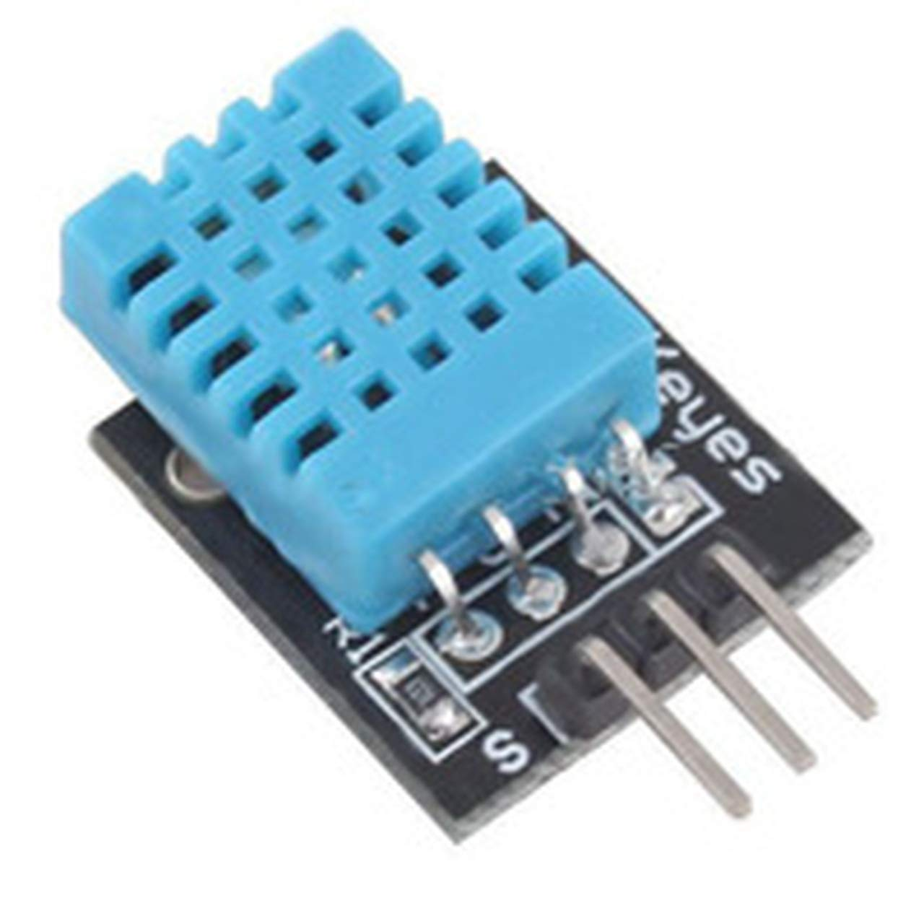
Components Used
ESP8266 ESP-01:
It is low power consuming Wi-Fi module with integrated TCP/IP protocol stack that can give any microcontroller access to WiFi network. It is self-contained SOC (System On a Chip) that doesn’t necessarily need a microcontroller to manipulate inputs and outputs.
DHT11:
It is a temperature and humidity sensor that generates calibrated digital output for temperature and humidity. It uses a humidity sensor and thermistor to measure surrounding environment. It has fast response and excellent quality.

Slide 45
Module-2
In the second module we are using Arduino as a microcontroller that will get the soil moisture through a moisture sensor and publish it to MQTT broker by using ESP8266 Wi-Fi module.

Slide 46
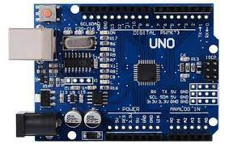
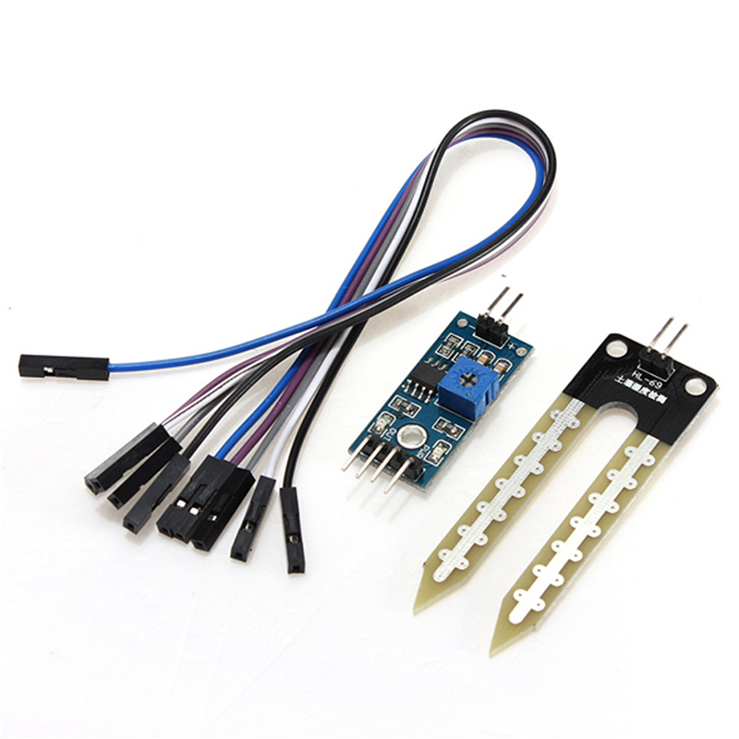
Components Used
Arduino Uno:
It is a microcontroller board based on the ATmega328. It has 14 digital I/O pins and 6 analog pins. It just need to connect with computer with a USB cable to upload the code and powered through a AC to DC adapter or a battery.
YL-69:
It is soil moisture sensor used to measure water content of soil. It can detect whether the soil is too dry or wet. This sensor uses the two probes to pass current through the soil, and then it reads that resistance to get the moisture level.
ESP8266 ESP-01:
It is low power consuming Wi-Fi module with integrated TCP/IP protocol stack that can give any microcontroller access to WiFi network. It is self-contained SOC (System On a Chip) that doesn’t necessarily need a microcontroller to manipulate inputs and outputs.

Slide 47
Module-3
In this module ESP8266 WiFi Module works as a subscriber who subscribes the moisture data from the MQTT Broker(Raspberry Pi). ESP8266 connected to relay i.e connected to motor and it will turn motor ON/OFF on the basis of soil moisture.

Slide 48
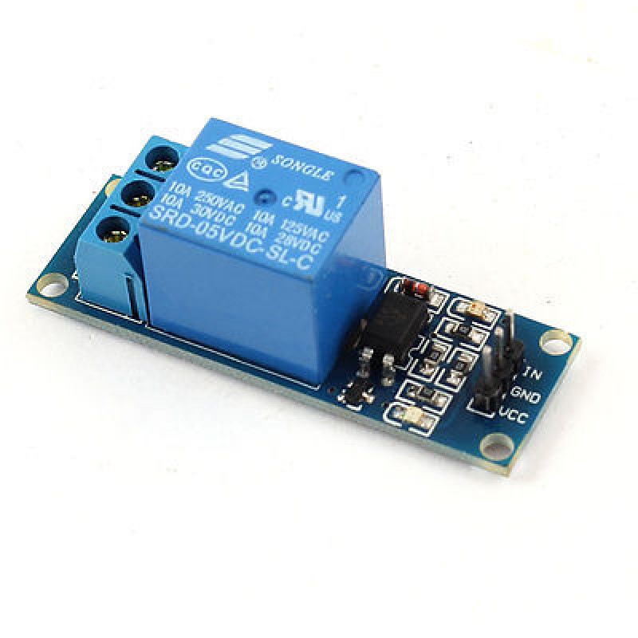
Components Used
Relay:
A relay is is an electrically operated switch. It means that it can be turned on or off, letting the current going through or not. when a relay contact is normally open (NO), there is an open contact when the relay is not energized. When a relay contact is Normally Closed (NC), there is a closed contact when the relay is energized.
ESP8266 ESP-01:
It is low power consuming Wi-Fi module with integrated TCP/IP protocol stack that can give any microcontroller access to WiFi network. It is self-contained SOC (System On a Chip) that doesn’t necessarily need a microcontroller to manipulate inputs and outputs.

Slide 49
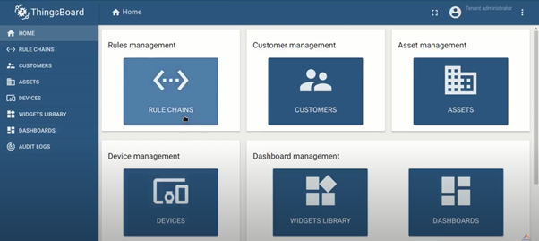
Think Board

Slide 50
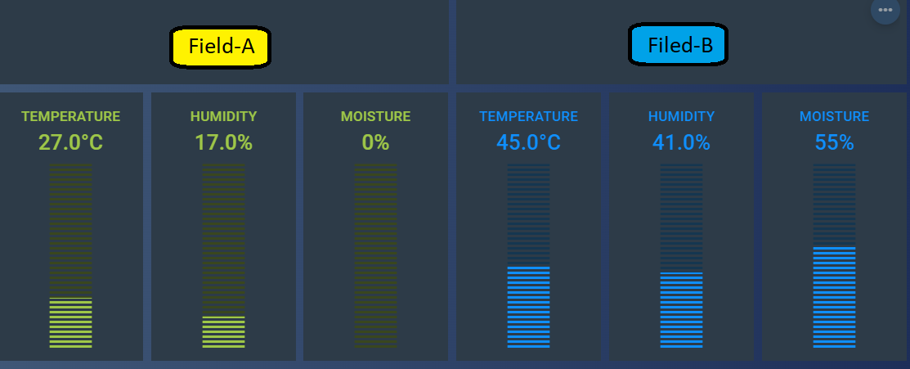

Slide 51
Future Scope
This system will include the intelligent system which will analyze the frequency of water supply to a specific crop on the basis of weather condition and will identify the amount of water required in the field to prevent the crop from damage and send this information to farmer via SMS or e-Mail to ensure the arrangement of enough water for healthy farming.
Machine learning can be used to detect unidentified objects like to prevent crops from animals using Camera Motion Sensor and further an image can be sent via MMS to farmer as alert message.

Slide 52


